Slide 1
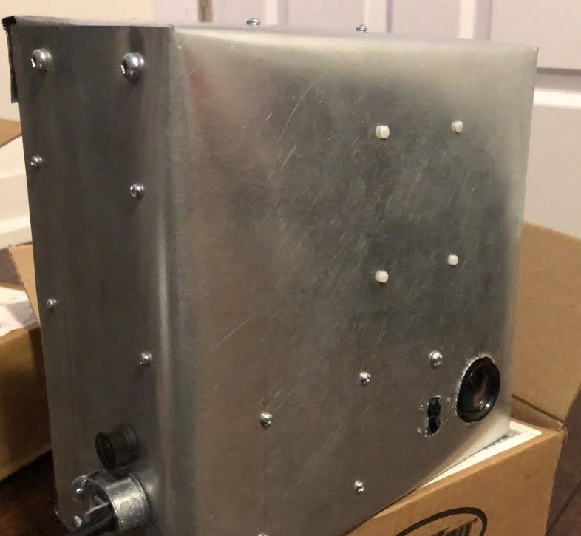
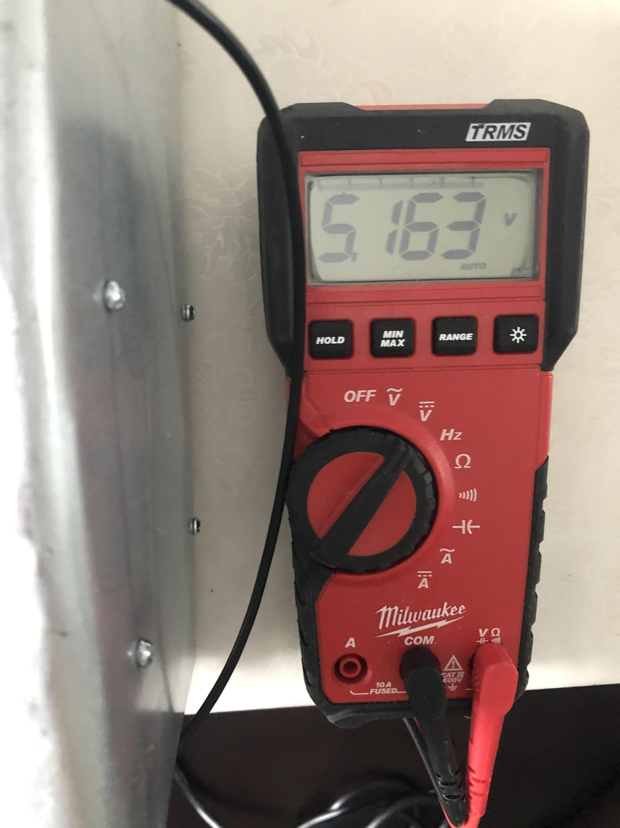
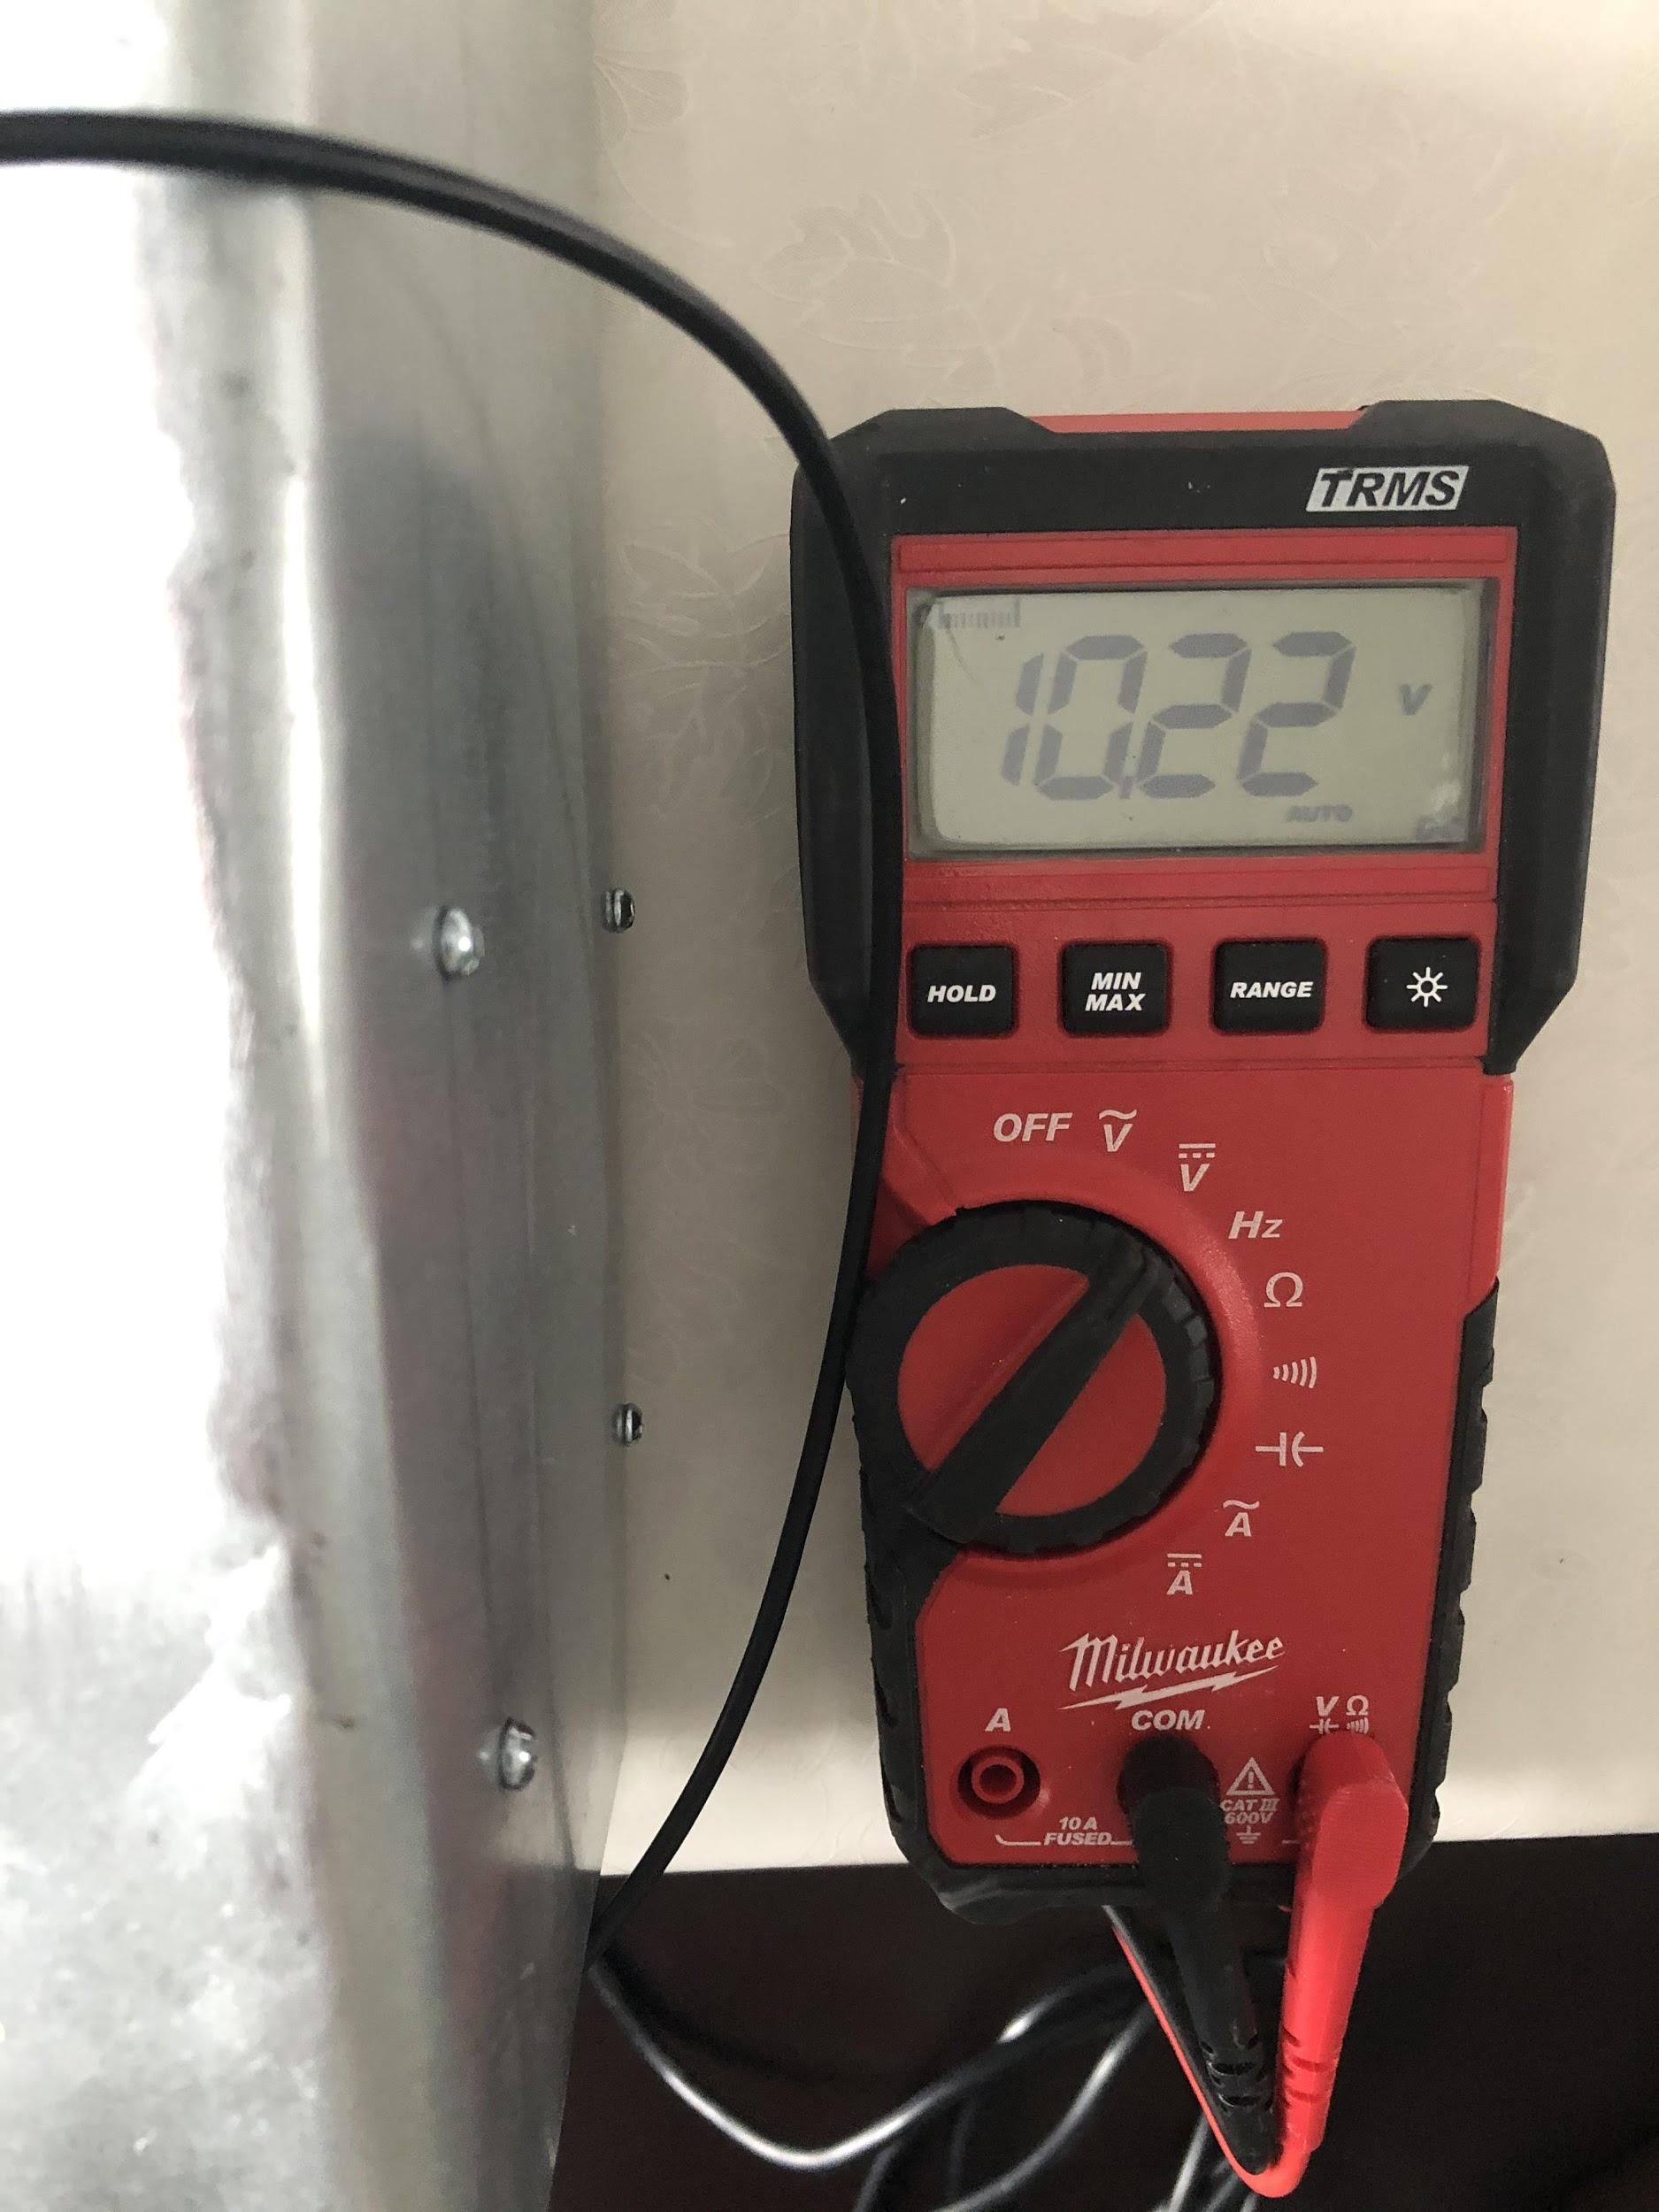
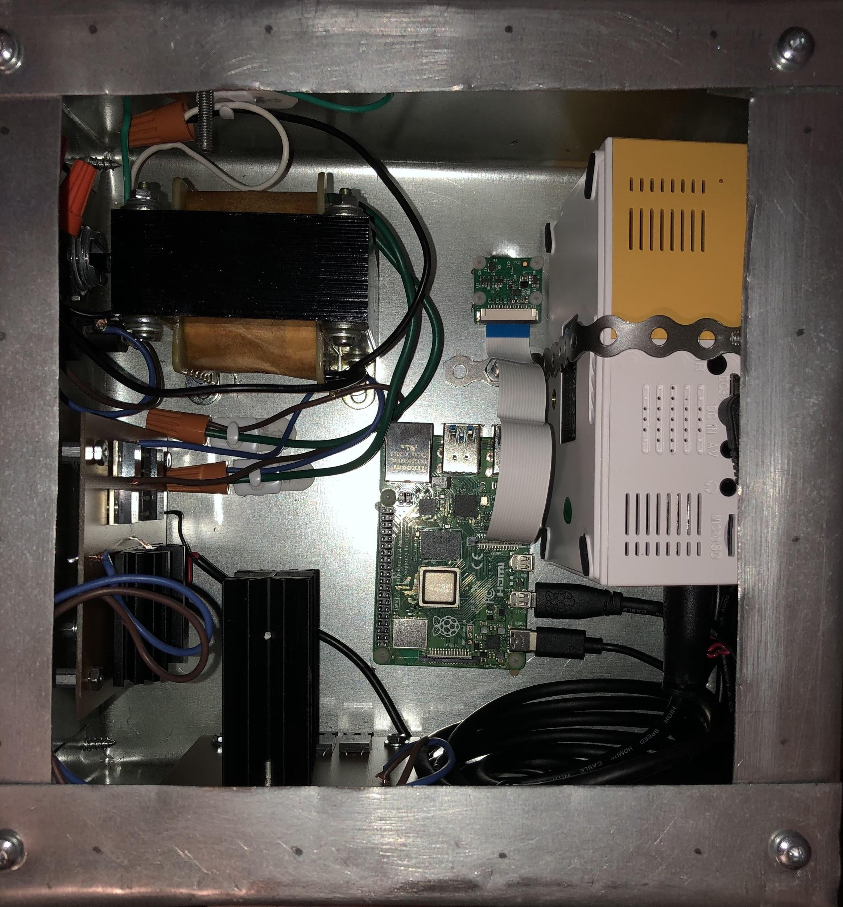
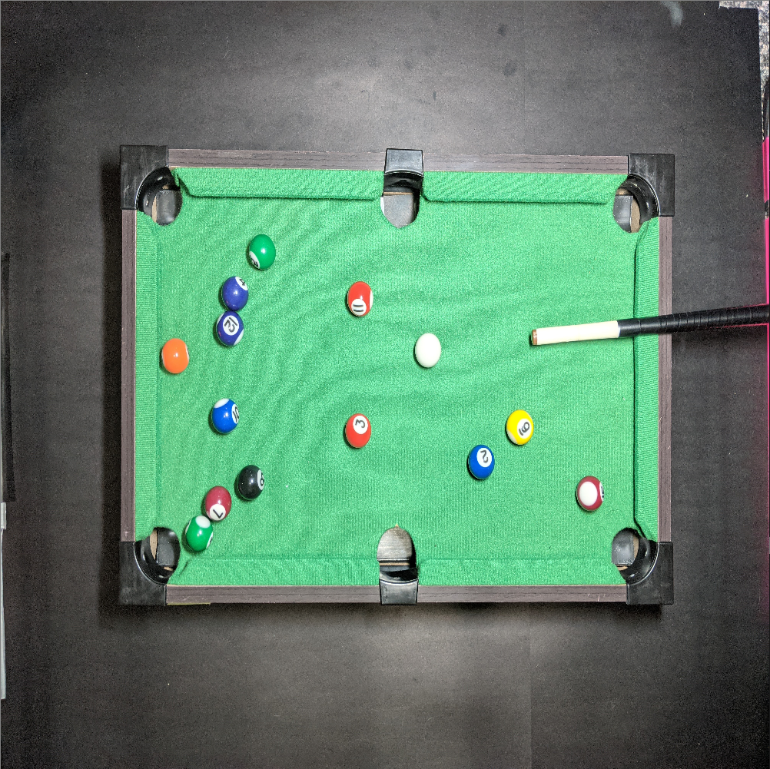
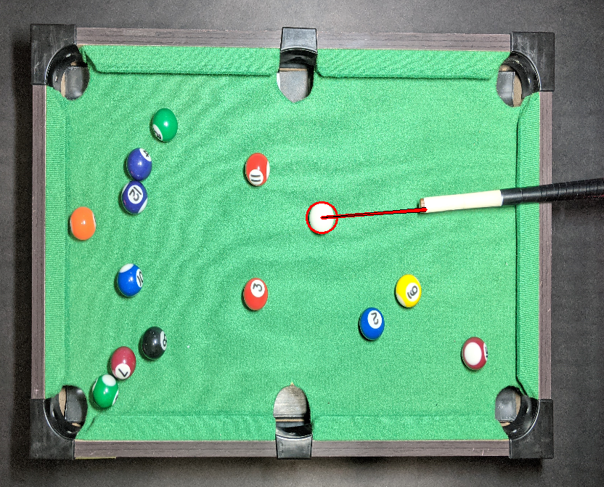
Virtual Pool Table
Matthew Ferreira Raposo & Omar Anabtawi
Description
Hardware Component
Chassis suspended over a pool table
Chassis identifies white ball and cue stick
Projector displays the line of travel of the ball while cue stick is aiming at it
Lines of travel will accurately display movement of white ball
Whole unit will be self sustaining
Process
Software Component
Design power circuit and identification code
PCB design & part ordering
PCB manufacturing & prototype testing
PCB assembly
Iterative development of analysis software
Chassis manufacturing
Final unit assembly
Troubleshooting
Original Image
Masking Layer
Final Output

Slide 2
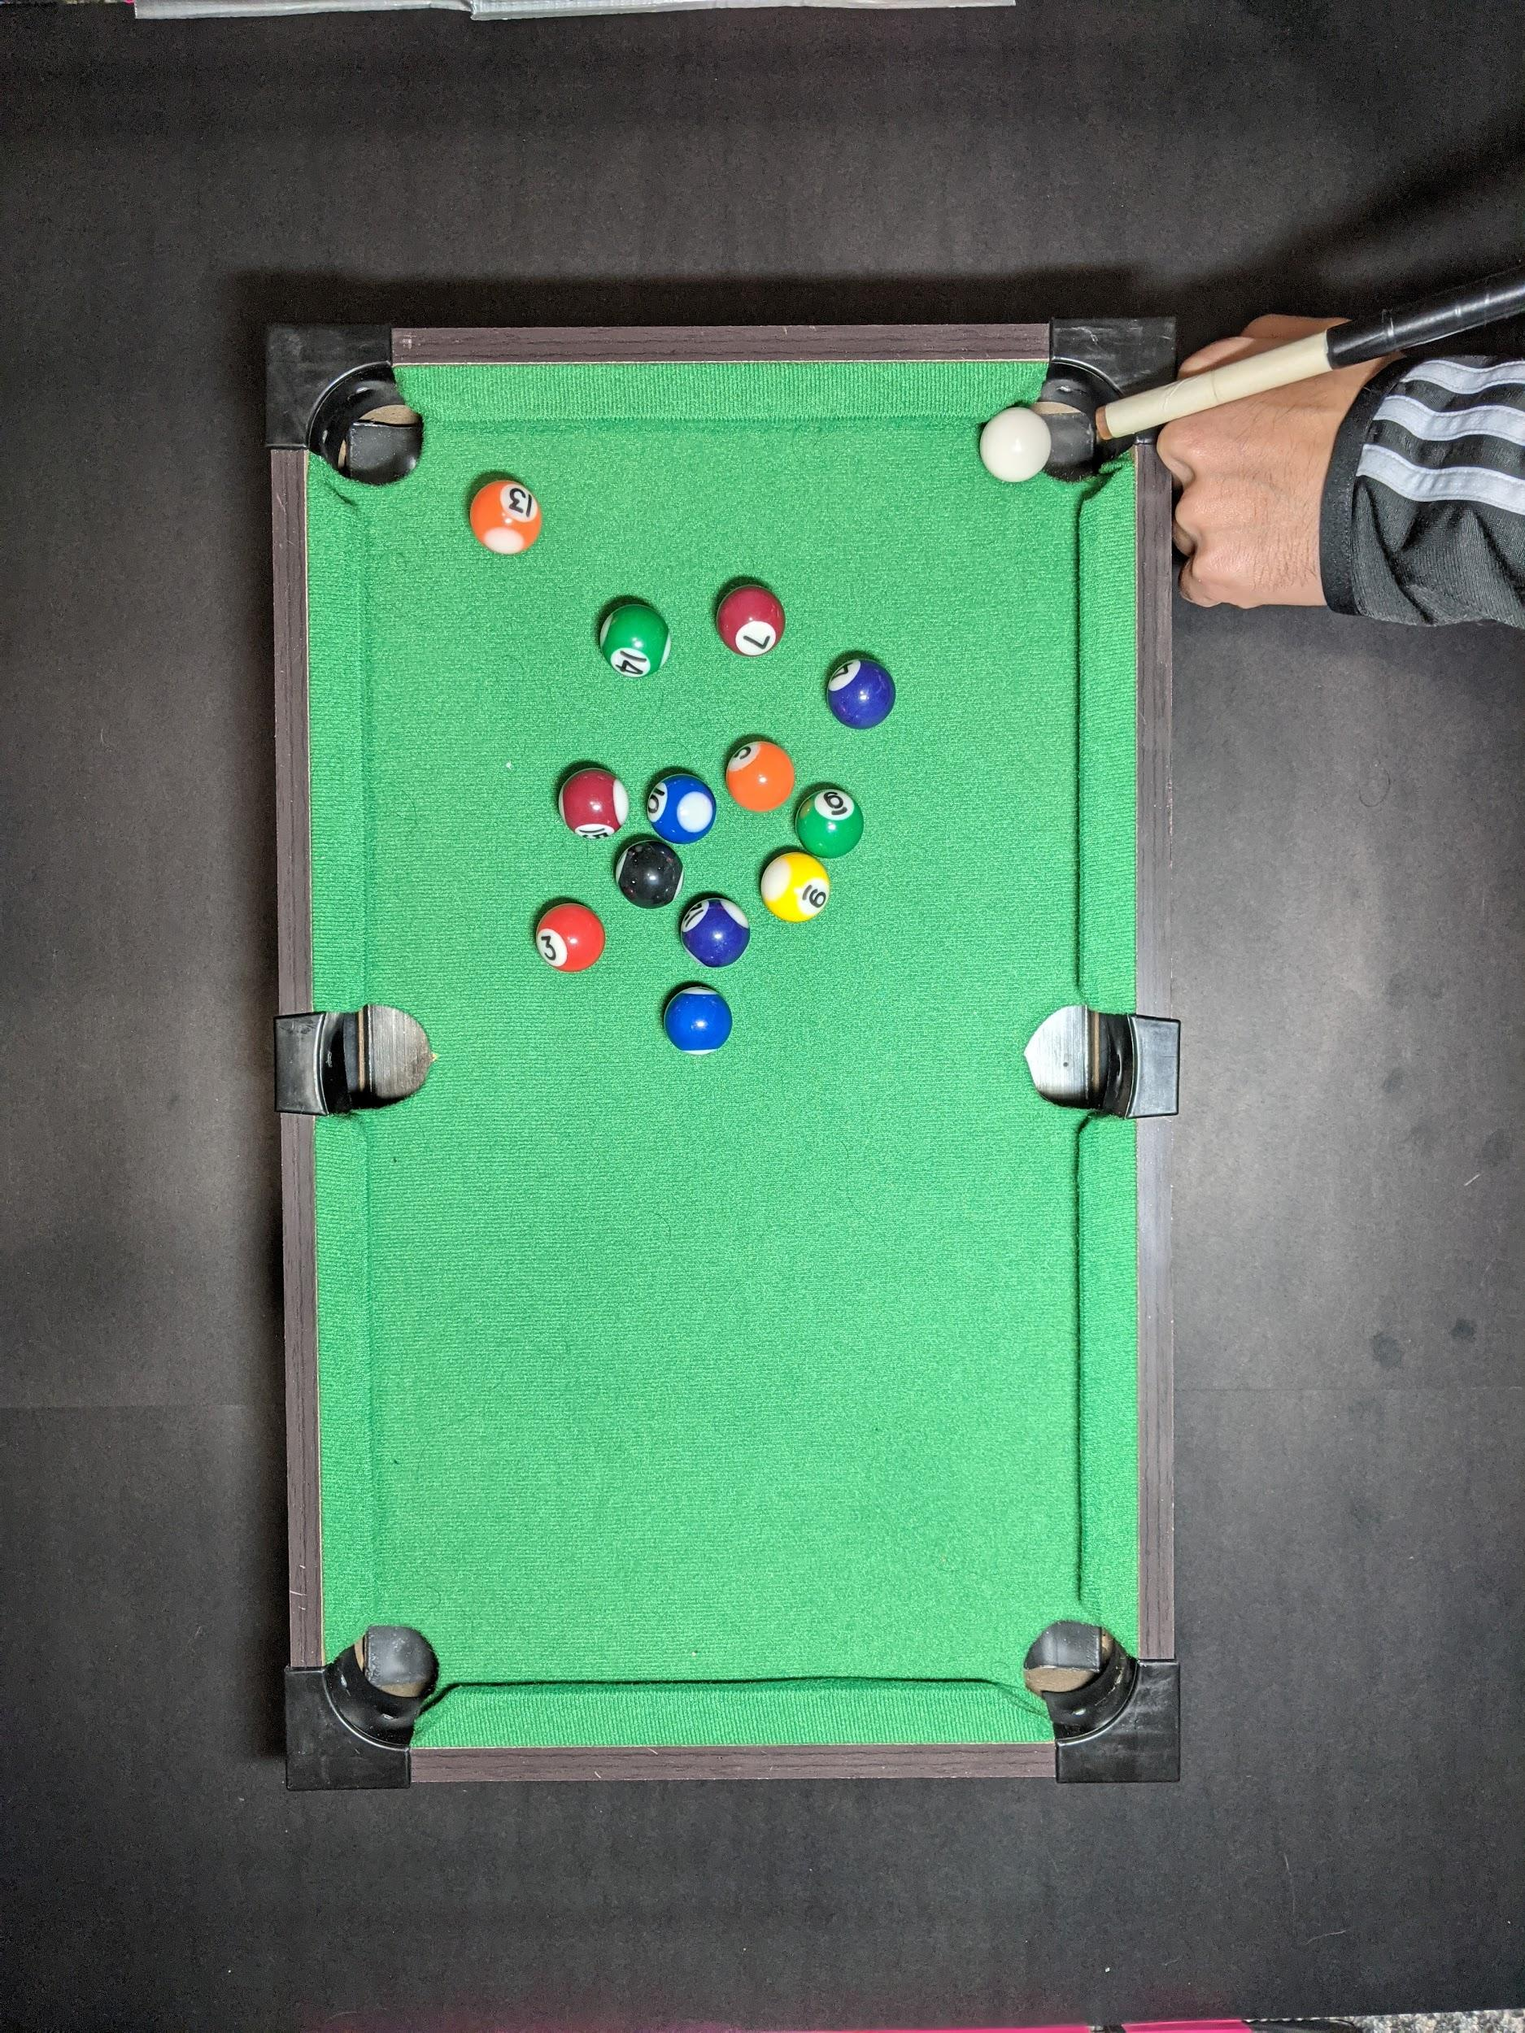
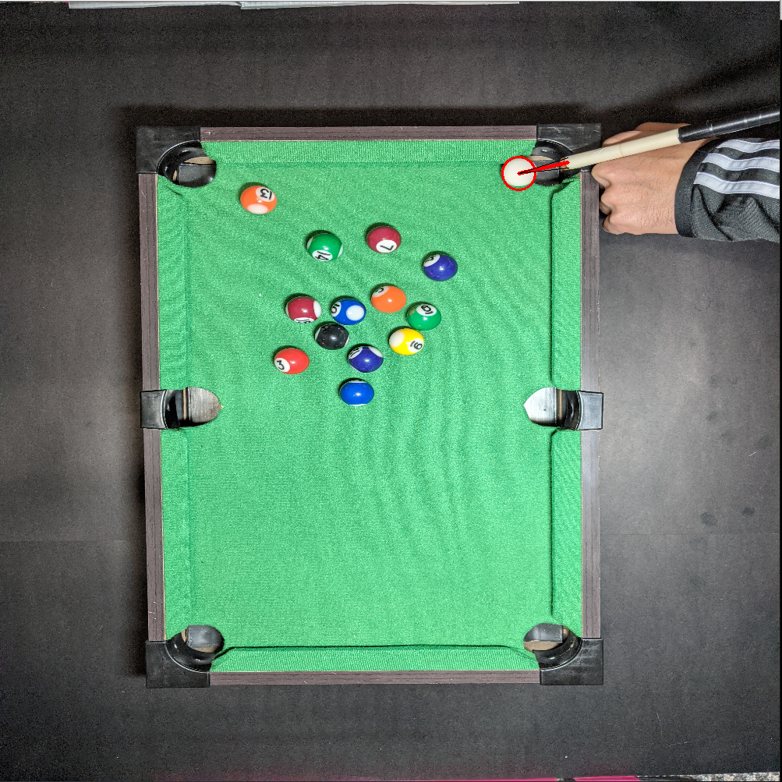
Virtual Pool Table
Idea
A chassis suspended over a pool table
Chassis interprets the balls and stick
Projector displays the line of travel of the ball while cue stick is aiming at it
Lines of travel will accurately interact with walls of the table
The whole unit will be self sustaining
The main problem are project is solving is helping beginners get better at the game.
Results
Hardware
Software
Plan
Design power circuit and identification code
PCB design/part ordering
PCB manufacturing/proto type test
PCB assembly and
Chassis manufacturing and
Troubleshooting
Final unit assembly
Troubleshooting

